Slide 1


Indoor Navigation App
Our Team :
Ajmera Himanshu
Bujala Anindith
Namani Sriveni
Sawant Dipali

Slide 2
Introduction
We have lot of outdoor navigation apps like google maps, and phone specific map applications, buzzclip, blindsquare etc helping us get through any kind of unknown location.
We not only get lost in outdoor places, but also inside big facilities/buildings like airports, malls etc, so there is a need for indoor navigation app.
Only few indoor navigation apps like google indoor maps, infsoft with limited features.

Slide 3
Introduction
Aim: to make indoor navigation app more usable and help in situations with limited time constraints.
We tried to build an indoor navigation app, naksha using cues from existing applications and improved its features gradually with feedback received.

Slide 4
Agenda
1. Introduction to naksha indoor maps
2. Low fidelity prototype – paper prototype
• face-to-face interview evaluation
• Remote usability evaluation – online survey
3. Model evaluation – paper porotype
• Improvements in digital prototype
4. High level prototype: digital prototype
• face-to-face interview evaluation
• Remote usability evaluation – online survey
5. Final Model evaluation and recommendations

Slide 5
Low fidelity Prototype
Build model with minimal features on paper.
1
Use it as a base to make further improvements.
2
Use to get feedback from potential users.
3

Slide 6
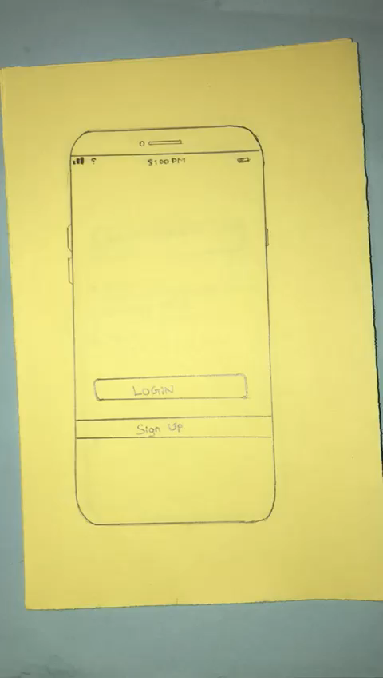

Paper prototype

Slide 7
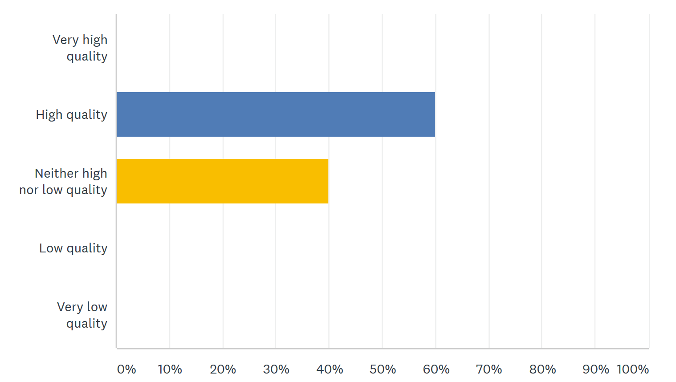
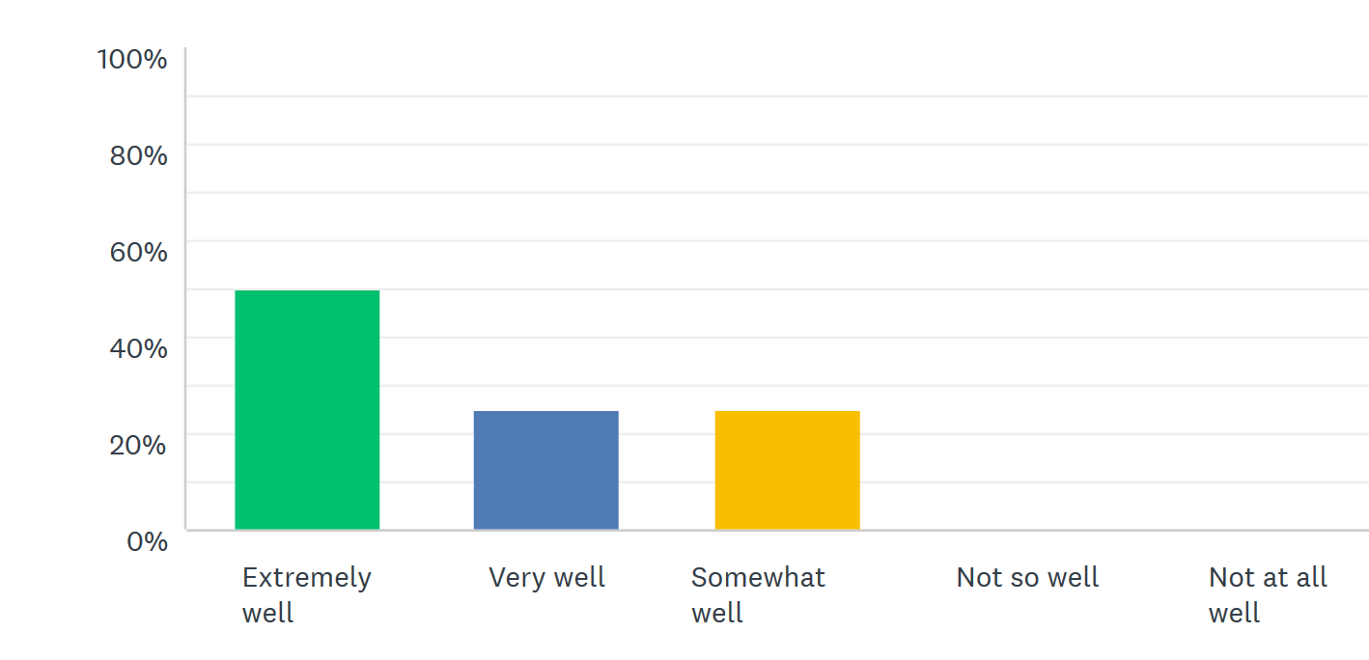
Model Evaluation : Paper Prototype
Quality of User Interface
How well UI meets your needs

Slide 8
High fidelity prototype: Improvements made in model-1
As per the survey, Logo is introduced in design.
1
A back button on the top of screen introduced.
2
Some extra features with decent UI Component introduced.
3

Slide 9
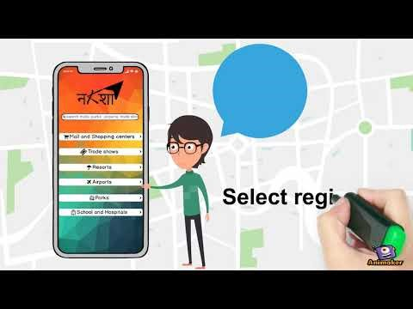
Digital Prototype
Let’s try our interactive build after this video

Slide 10
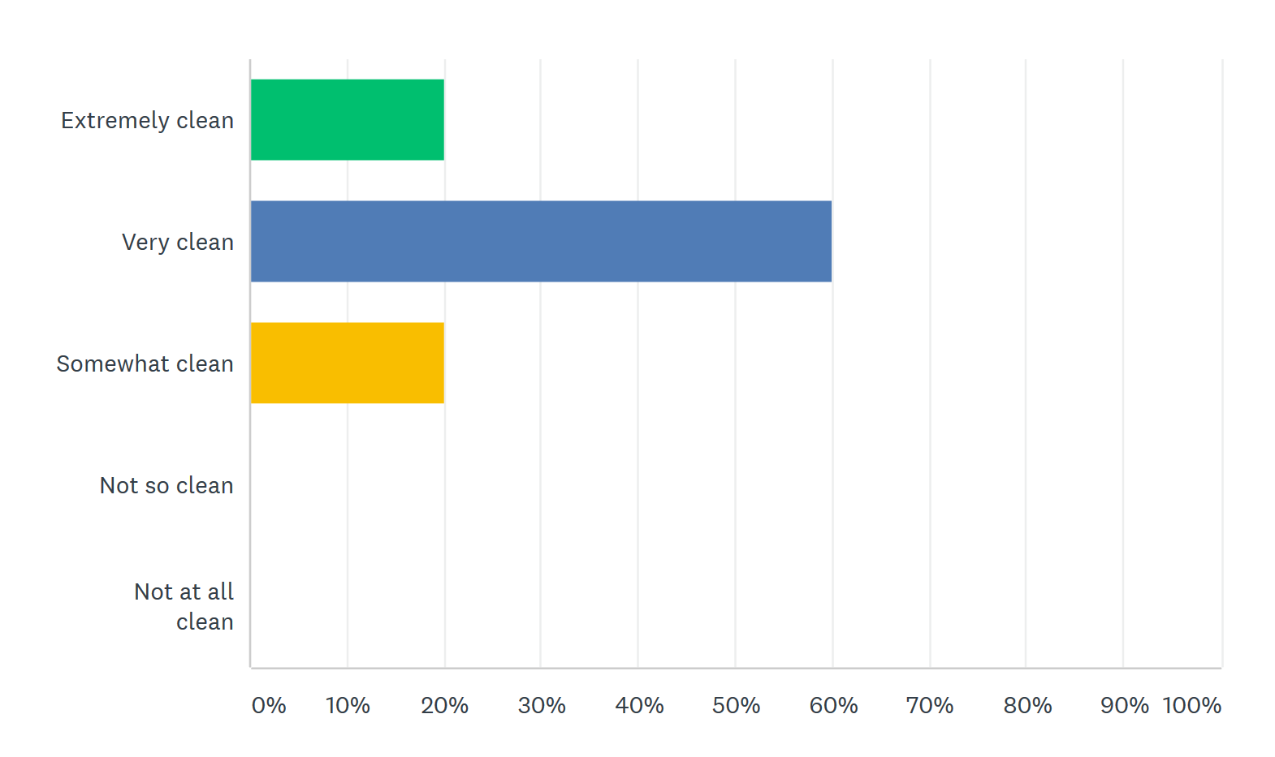
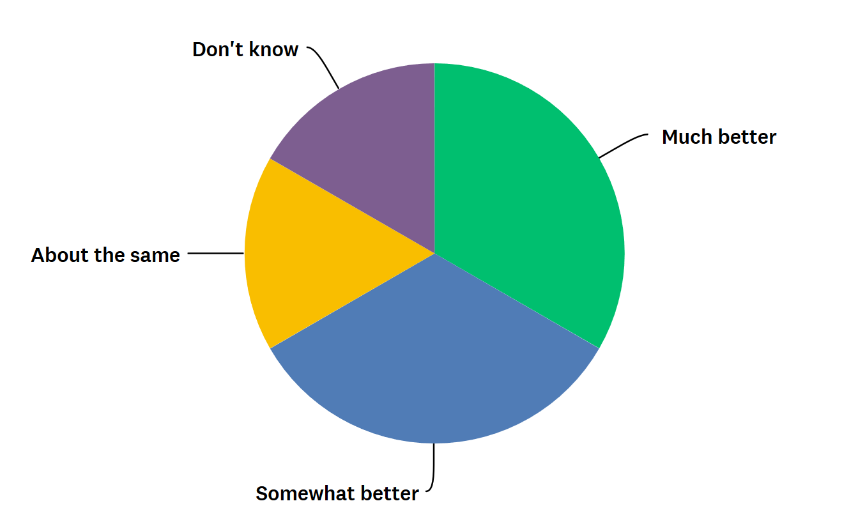
Model Evaluation: Digital Prototype
How clean and easy was UI design?
UI design as compared to our competitors

Slide 11


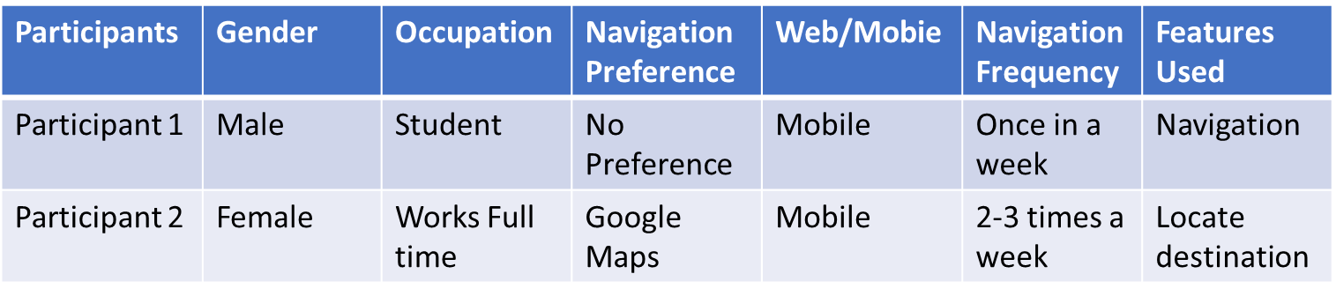
Interview face-to-face: participants demographics
Evaluation:
Based on the feedback from our interviewees, the application, Naksha developed was easy to use and users were satisfied, but there were few recommendations to make it better in terms of user understandability and graphical interface and regarding addition/removal of few features of the app.

Slide 12
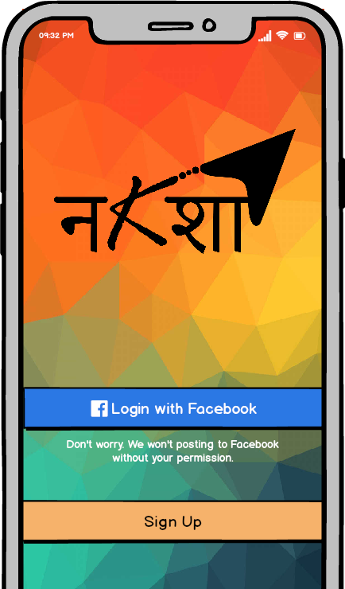
Final Model Evaluation:
Issues identified in face-to-face evaluation appeared consistently in and remote testing
Users were more familiar with the mobile interface, still there was demand for web interface.
Operating features within Naksha maps was challenging for most users of all experience levels
Our Observation:
Face-to-face Interview
Can easily engage user into performing tasks
Users are more hesitant to offer opinions - feed off of moderators energy
Remote – Online Survey
Harder to build a relationship with user over web
Users in a more comfortable environment- offer opinion more freely

Slide 13
Recommendations for Future Model
Mobile/web consistency :
Design interfaces with the same icons/layout to improve user efficiency
Improve icons :
Design icons that convey a clearer message of their function
Options menu :
Improve the layout and placement of the menu so that users are more aware of it
Nearby feature:
Update information pages of places with more user reviews to gain user trust of the feature

